Slide 1
PPS
PROGRAMMING FOR PROBLEM SOLVING - MINI PROJECT
BY
RAVYATHA KEERTHI MOLLETI (RA2111030010274)
AMARA VENKATA DILEEP (RA2111003011816)
SHAILY RANI (RA2111030010278)

Slide 2
Relational operators in C
In computer science, a relational operator is a programming language construct or operator that tests or defines some kind of relation between two entities. These include numerical equality (e.g., 5 = 5) and inequalities (e.g., 4 ≥ 3).
The Relational operators are used for comparison of the value of one element with another. There are six types of relational operators: equal, greater than, less than, greater than or equal to, less than or equal to, and not equal to. Each of these operators can be used to compare the values of the variables.
Relational Operators Meaning
>= Greater than or equal to
<= Less than or equal to
== Equal to
!= Not equal to

Slide 3
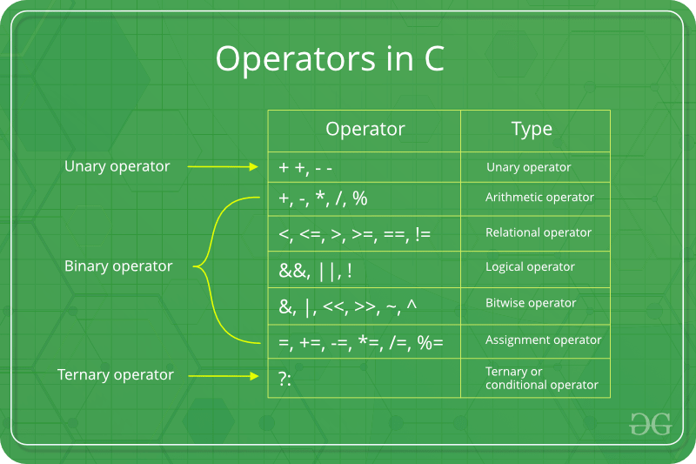

Slide 4
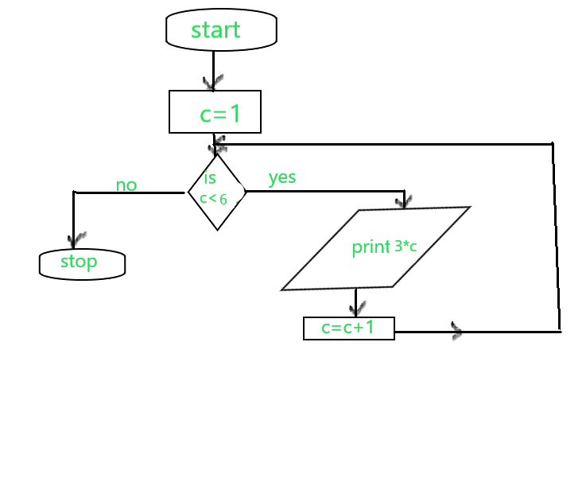

Slide 5
Problem :
Raj has following types of taxi .
Ola taxi :It can be booked by online application fron phone.
Fastrack taxi : I can be booked anywhere on road.
The Ola taxis costs ‘Oc’ for the first ‘Of’ km and ‘Od’ for every km afterwards.The Fastrack taxis speed is ‘Cs’ per minute.
He is going to office from his home . Task is to minimize the cost he required to pay. The distance between the office and home is ‘D’. We
have to select whether he want to use Ola or Fastract to go to his office.
If both cost same ,then he must use an online taxi.

Slide 6
Input formate: First line : Single integer ‘D’ ,Denotes the distance between office and home. Second line: three integers Oc,Of and Od. Third line : four integers Cs,Cb,Cm and Cd. Output formate: If raj take Ola than print Ola Taxi otherwise print Fastrack Taxi.

Slide 7
ALGORITHM
Calculate the Ola Taxi fare , than Fastrack Taxi fare .
Compare the fare of of ola Taxi fare and Fastrack Taxi fare .
If Ola fare is greater than Fastrack fare than print Fastrack Taxi.
If Ola fare is smaller than Fastrack fare than print
Ola Taxi.

Slide 8
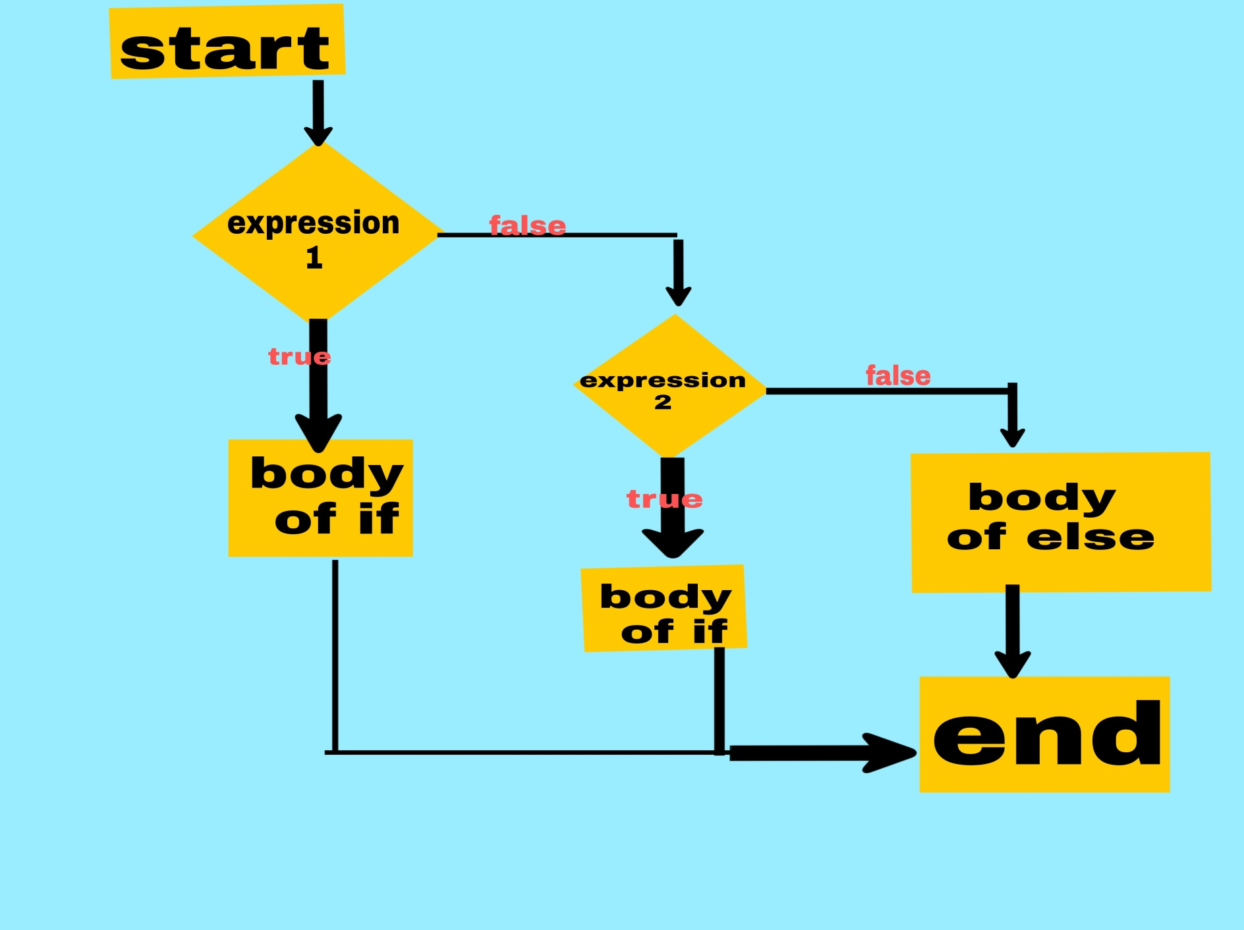

Slide 9
Code used :
#include <stdio.h>
int main()
{
int D,Oc,Of,Od,Fs,Fb,Fm,Fd;
scanf("%d",&D);
scanf("%d %d %d",&Oc,&Of,&Od);
scanf("%d %d %d %d",&Fs,&Fb,&Fm,&Fd);
int olacost=Oc+(D-Of)*Od;
Intftcost=(D/Fs*60)*Fm+D*Fd+Fb;
if(olacost>ftcost)
{
printf("Fastrack Taxi");
}
else if(ftcost>olacost)
{
printf("OLA Taxi");
}
else{printf("OLA Taxi");
}
return 0;
}

Slide 10
Sample output :
150
30 30 30
30 30 30 30
“Ola Taxi”

Slide 11
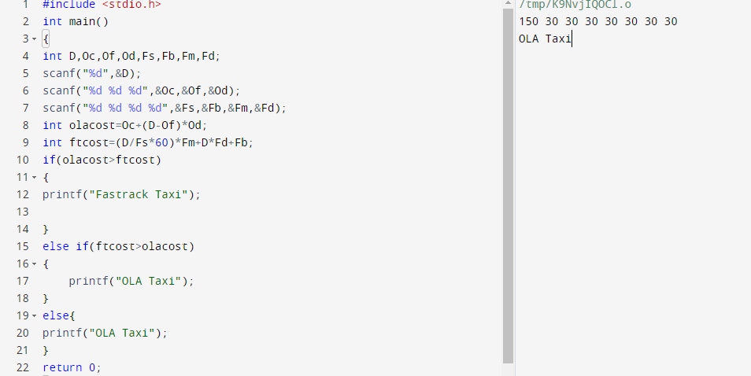

Slide 12
Conclusion:
if-else statement is used for decision making in programming . If the given condition is true, then the code inside if block is executed, otherwise else block code is executed. Since if-else statement control the flow of the program, it is also called as Control Flow statement.

Slide 13


